Slide 1
Community for Emerging and Zoonotic Diseases Identifying emerging risks through collective intelligence
CEZD – CAHSS Equine Network Update
7 December 2023
www.cezd.ca

Slide 2
USDA APHIS | Vesicular Stomatitis
Since our last meeting there has been another peak of VSV cases in the US
New cases in California in 7 new counties
Northward expansion of cases

Slide 3
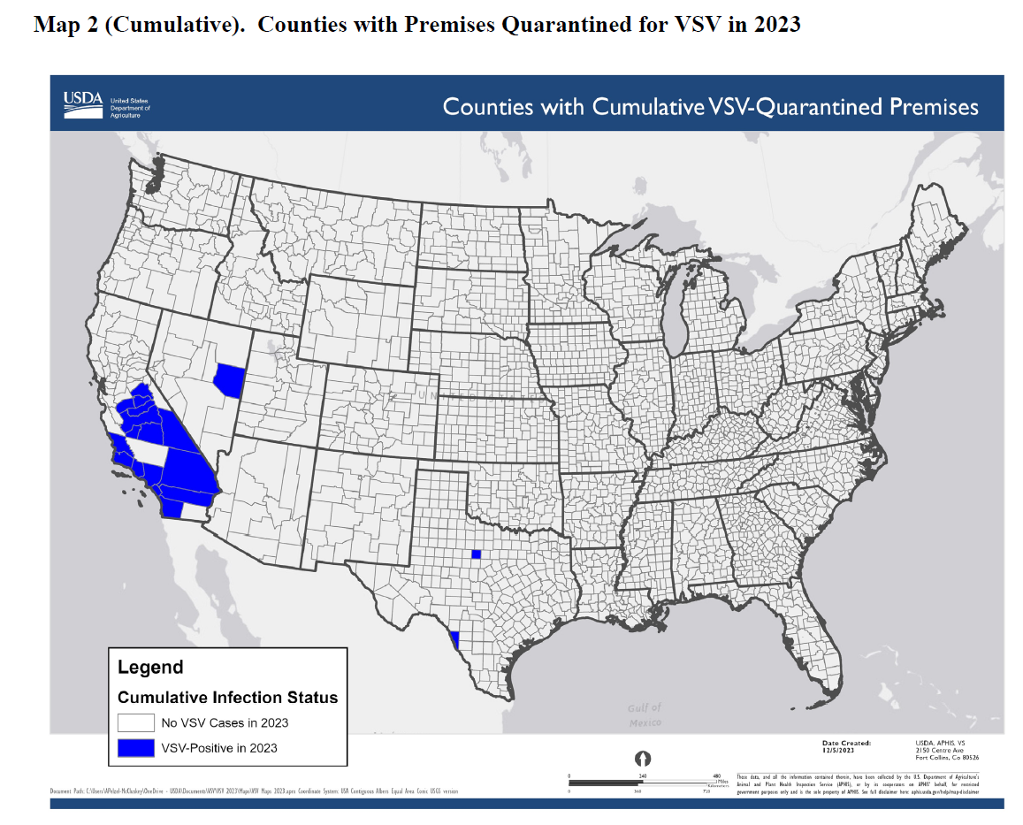
USDA APHIS | Vesicular Stomatitis
All active quarantines are in California
310 total premises affected
307 California
1 Nevada
2 Texas
91 confirmed positive
219 suspect
USDA APHIS | Vesicular Stomatitis
Situation Report from 5 Dec 2023

Slide 4
EEE Hazard Trend

Slide 5
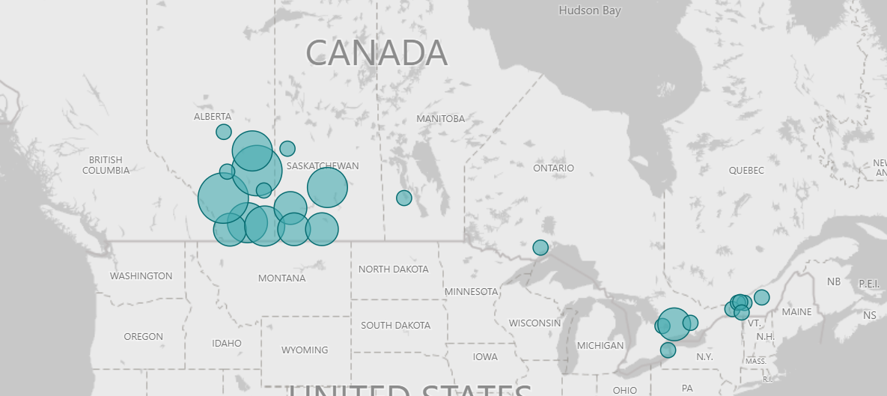
West Nile Virus Hazard Trend
Question: Are cases occurring later than usual?

Slide 6
Germany is on alert. The first case of a deadly virus reported (essanews.com)
Fatal human case of Borna virus disease in Bavaria (BoDV-1)
Virus causes meningitis, almost always fatal
In humans, detected only in Germany, almost all cases in Bavaria but one case in Brandenberg

Slide 7
Investigation of fatal human Borna disease virus 1 encephalitis outside the previously known area for human cases, Brandenburg, Germany – a case report | BMC Infectious Diseases | Full Text (biomedcentral.com)
59 year old German farmer
Over course of 3 weeks 2017 went from healthy
Headache, malaise, fatigue
Nausea and neurological symptoms
High fever, paraplegia, coma, brain death
BODV-1 present on two alpaca farms and a horse farm 35 km from the human case in Brandenberg

Slide 8
Investigation of fatal human Borna disease virus 1 encephalitis outside the previously known area for human cases, Brandenburg, Germany – a case report | BMC Infectious Diseases | Full Text (biomedcentral.com)
Reported in animals in Germany, Liechtenstein, Switzerland and Austria
Primary host and reservoir of the virus is the bicoloured white toothed shrew
Virus excreted in urine, feces and saliva
Horses and sheep are hosts

Slide 9
Clinical Signs in Horses
Sporadically occurring, progressive viral polio-encephalomyelitis
Incubation period of weeks to months
If clinical, locomotor and sensory dysfunction can result in paralysis and death
Important neurological disease in horses in Germany
Declining in importance over last 200 years
Some cases may be sub-clinical
Seroprevalence between ~11 to 22% in healthy horses in Germany
Serosurveillance studies show BDV positive cases around the world, but disease appears only in Germany

Slide 10
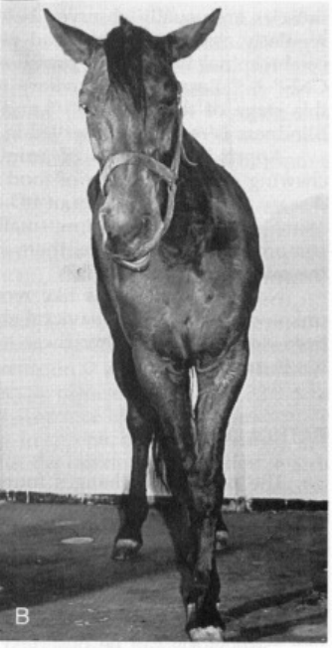
Borna Disease in Horses - ScienceDirect
Notes:
Figure 2. Horses with Borna disease. A, A 7-year-old gelding affected with somnolence and displaying characteristic arrested eating with chewing movements (called “Pfeifenrauchen” or “pipe smoking”). B, A 2-year-old mare affected with disturbances in proprioception (abnormal posture) and paralysis of the facial nerve. C, A 17-year-old Welsh Pony stallion with neurogenic torticollis and compulsive circular walking.

Slide 11
Borna Disease Virus (BDV), a (Zoonotic?) Worldwide Pathogen. A review of the History of the Disease and the Virus Infection with Comprehensive Bibliography (wiley.com)
Horses dead from Borna Disease 1958-1990 (Saxony, Germany)
Correlates with decrease in horse population in agriculture
Question: is this ever considered in neurological cases in horses in Canada?
Where another diagnosis is not clear would we even look?

